Slide 1



PRESENTED BY TEAM
TECH TITAN
PAWAN BAAG SAURYA SUDARSHAN PURUSHOTTAM SAHU HEMANT SAHU

Slide 2
PROBLEM OVERVIEW
cultural and social norms suppporting gender ineqaulity
weak legal enforcement of law and protection
poor urban infra structure dark streets unsafe road digital anonymity enabaling online harassment
economic dependency restricting
TECH TITAN

Slide 3

OUR SOLUTION
wearable safety band - A wristband
purpose - designed to improve personal safety
size - small and discreet .
accessibility - always on hand (worn on the wrist )
Advantage - fasted to use emergency compared to a
phone
TECH TITAN

Slide 4

KEY FUNCTION
panic button - Activated the device
GPS modul - Track and the provide live location. microphone - Captures voice input
voice -to - text -Convert the recorded voice into text using programming
sim - connect to the nearest mobile network tower.
message sending - send the location + converted to text message to friends/relative/police emergency help line number
TECH TITAN

Slide 5
WOMEN SAFETY WATCH DEVICE

Slide 6
TECH STACK
PYTHON- CORE LANGUAGE USUEDTO IMPLEMENTSPEECH RECOGNIZATION
ANDBACKENDLOGIC
SPEECH RECOGNIZATION - CAPTURE AND PROCESS VOICEINPUTWHENTHEPANIC BUTTON IS PRESSED.
SOUND DEVICE - FOR ACCESSING THE MICROPHONEINREALTIME.
TECH TITAN

Slide 7
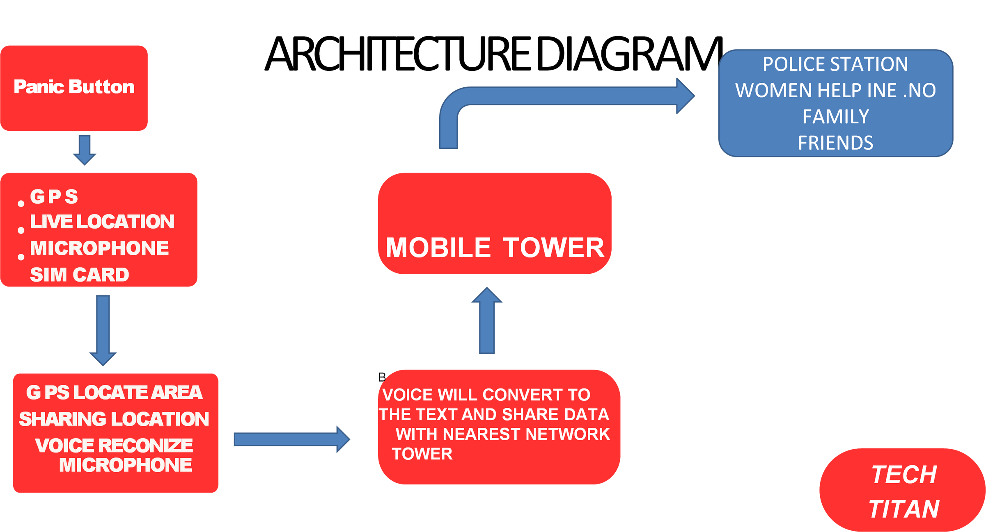

Slide 8
FUTURE SCOPE
AI BASED ANOMLY SENSING DETECTS SUDDEN MOVEMENT,
STRESS OR FALLS AND AUTO TRIGGERS ALERTS. EMERGENCY COMMUNICATION USES BLUTOOTH MESH NETWORKING OFFLINE ALERT SYSTEM AND DIRECT POLICE INTEGRTION.
TECH TITAN

Slide 9
ROLE OF TEAM MEMBER
PAWAN BAAG :- ALERT AND VISUAL CREATION SAURYA SUDARSHAN:-MODEL TRANING AND FEATURE DESIGN
PURUSHOTTAM SAHU:- FRONT END CREATOR HEMANT SAHU:-BACK END CREATOR
TECH TITAN

